Slide 1
Public Safety Canada
2019-20 Departmental Financial Situation
Presentation to the Minister
RDIMS: 3392544

Slide 2
Outline
 | Page
Main Estimates 2019-20 | 2
Main Estimates 2019-20 - Vote 5 Grants & Contributions | 3
Supplementary Estimates | 4
Sunsetter Funding - Ends in 2019-20 | 5
Delegation of Financial Signing Authority | 6

Slide 3
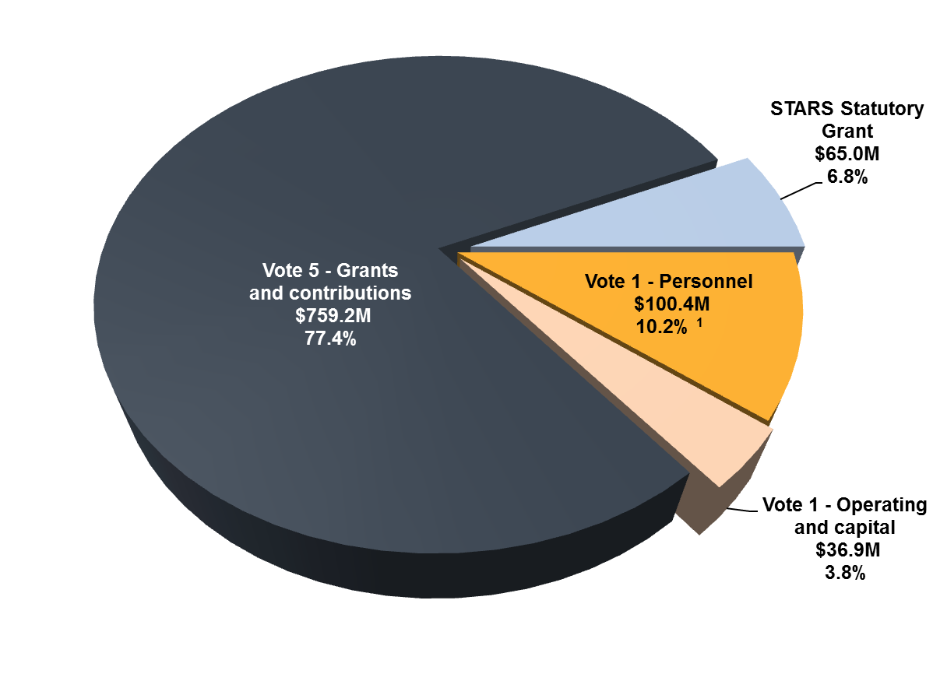
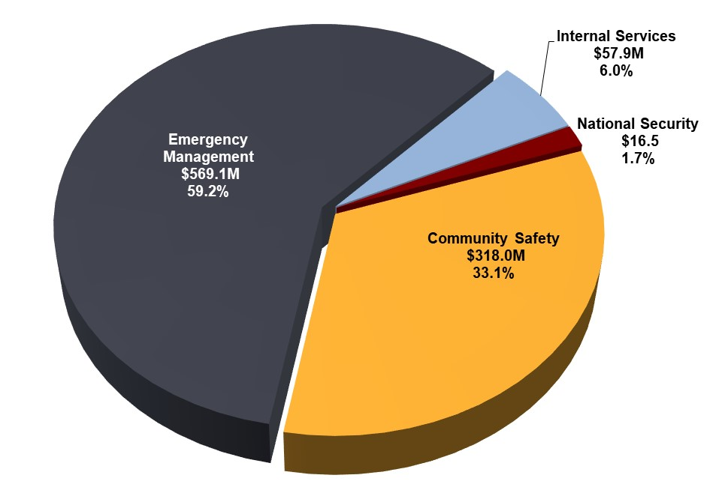
Main Estimates 2019-20
The Department manages two (2) voted appropriations:
Vote 1 – Operating expenditures ($137.3 million):
Main Estimates have increased by 19.2% over the last five years (from $115.2 million in 2014-15 to $137.3 million in 2019-20).
Vote 5 – Grants & Contributions ($759.2 million):
Main Estimates have decreased by 23.5% over the last five years (from $993.0 million in 2014-15 to $759.2 million in 2019-20). This is mainly related to temporary fluctuations in the timing of payments to be issued to provinces and territories for the Disaster Financial Assistance Arrangements (DFAA) program.
2019-20 Main Estimates by Vote and Statutory Grant
2019-20 Main Estimates by Core Responsibility
¹ Vote 1 - Personnel expenditures represent 1,136 FTEs

Slide 4
Main Estimates 2019-20 - Vote 5 Grants & Contributions
The following table presents the programs funded through PS’ Vote 5 in 2019-20
Total Grants & Contributions: $759,205,353
Notes:
NCPS Continued lapse
NCPS has historically lapsed program funding (6.3%-25.5%) even after proceeding with transfers of funding to First Nations Policing Program (FNPP) and other programs. Without those transfers the revised NCPS lapses would have been significantly higher (10.2%-30.1%).
Process of developing a framework to address this pattern of recurring lapse
Risk is the program may be vulnerable to scrutiny from Central Agencies in the future, including possible re-allocation of funding.
FNPP
In-year transfers to RCMP for FNPP approx. $40M-$45M
New G&C Programs
National Disaster Mitigation Program (NDMP) – ME (Contributions)
Moncton Memorial - SUPPS A (Grants)

Slide 5
[Redacted]

Slide 6
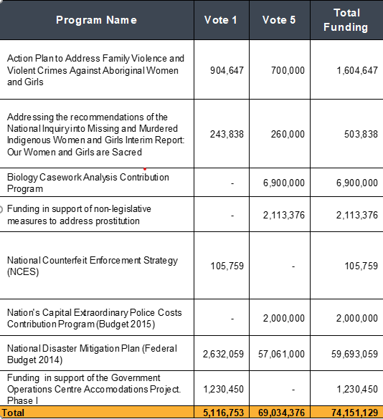
Sunsetter Funding - Ends in 2019-20
[Redacted]

Slide 7
Delegation of Financial Signing Authority
The Delegation of Financial Signing Authority (DFSA) allows Ministers to delegate their financial authorities associated with the expenditure process to authorized positions within the Department.
The DFSA sets strict limits on approval levels that are consistent with Treasury Board policy and ensures an appropriate segregation of duties within the payment process.
In this manner, the DFSA defines clear accountabilities for the exercise of financial authorities while ensuring that management controls are appropriate to the level of risk.
Departments are required to provide new Ministers with an updated DFSA for approval within 90 days of a transition.
Until the new DFSA is approved, departmental officials will continue to exercise financial authorities that were conferred under the previous DFSA.

